Slide 1
Azure Immersion Workshop: Infrastructure Migration
Session 2: Introduction to Azure Migrate, SMART, and other tools.
May 2020
Speaker Name

Slide 2
Cloud Adoption Framework
Define strategy
Plan
Ready
Adopt
Govern
Manage
Notes:
Before beginning migration, ensure the preceding steps are done in strategy, plan, ready.
Briefly touch on entire cloud adoption journey – importance of building business case for migration and doing the proper planning to ensure you have the business readiness to migrate. Once you’re ready to migrate, Microsoft has first party tooling to help you assess technical feasibility and readiness for migration, prepare your workloads, and migrate those workloads quickly and securely. All the while, maintaining governance and managing your operations should be an ongoing activity to ensure your business is running securely and efficiently in the cloud.

Slide 3
Tools, templates, and assessments
Define strategy
Plan
Ready
Adopt
Cloud journey tracker
Business outcome template
Cloud adoption plan generator
Azure DevOps demo generator
Cloud adoption plan template
Azure setup guide
Readiness checklist
Naming and tagging tracking template
Landing zone blueprints
Strategic migration assessment and readiness tool (SMART)
Azure migration guide
Azure innovation guide
Govern
Manage
Governance benchmark
Governance process template
Cost Management process template
Deployment acceleration process template
Identity process template
Resource consistency process template
Security baseline process template
Azure architecture review
Best practices source code
Operations management workbook
aka.ms/adopt/tools-templates
Notes:
Templates, frameworks, and guides to plan and track your migration before, during, and after (Excel, documentation, etc.).

Slide 4
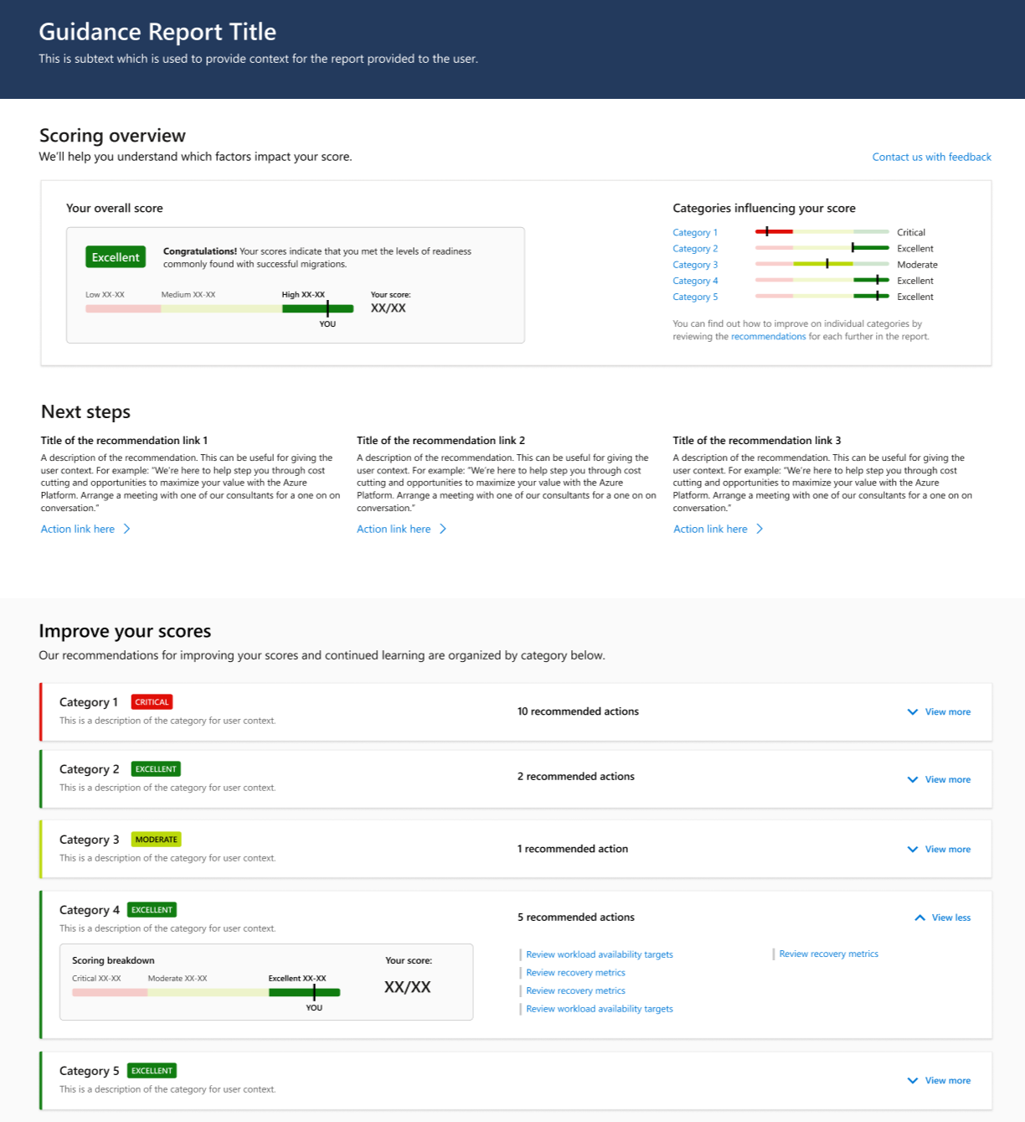
Before we begin..
Assess your migration readiness
using the “Strategy Migration Assessment and Readiness tool” across 10 readiness areas
https://aka.ms/smarttool
Notes:
Understand migration readiness – initial strategy to ongoing management.
Assesses business readiness – do you have the right migration plan for your organization, does your organization have proper support for this plan
17 multiple choice questions; ex. Do you have a plan for how a migration partner will support you during and after the project?, Have you identified the set of applications in scope for the migration project?

Slide 5
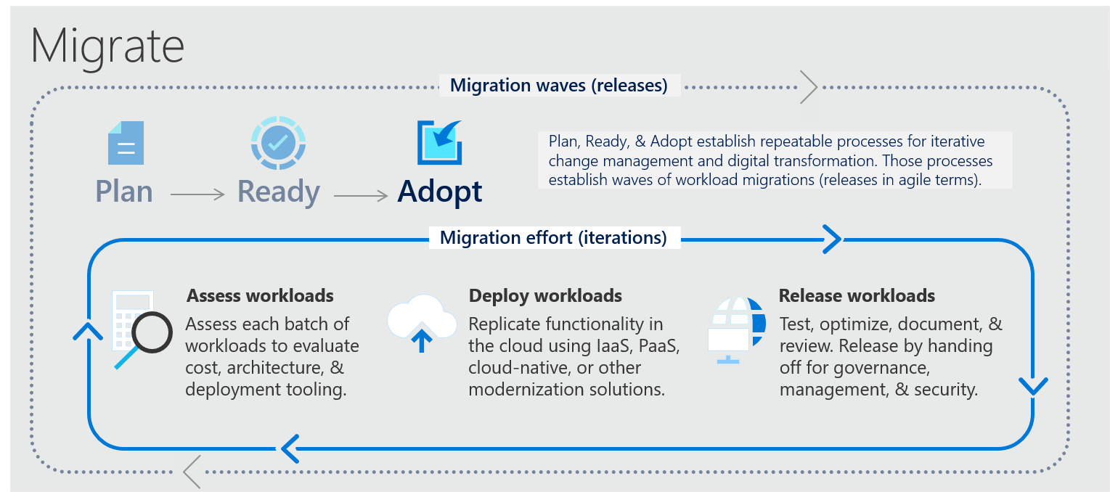
Adopt: Migrate
Before proceeding with migration execution, it is required that all the upstream steps of Strategy, Plan and Ready are completed. Key deliverable assets of these phases include – Cloud Adoption Plan template and a landing zone configuration
Notes:
Azure Migrate covers assess, deploy, and release steps of the migration iteration.

Slide 6
Migration tooling options
Assess workloads
Deploy workloads
Release workloads
Azure Migrate
Data Migration Assistant (DMA)*
Azure Database Migration Service
Azure Cost Management
SQL Server Migration Assistant (SSMA)
Azure Data Box*
Azure Advisor
Azure Monitor
Azure Security Center
ISV solutions (as needed)
RackWare*
Carbonite*
Corent*
CloudLab*
TSO Logic
Lansweeper
CloudEndure
Cloudamize*
Device42*
Lakeside*
Zerto*
UnifyCloud*
Turbonomic*
Flexera*
*Also integrated with Azure Migrate
Notes:
Our goal is to enable successful Azure migration, regardless of what tool was used.
We have a comprehensive set of first party Azure tools that are built into the Azure portal and free to get started.
But we also have a great set of third party tools for additional scenarios and specific busines needs. For example: Cloudamize and UnifyCloud have richer TCO capabilities than Azure Migrate does. Similarly, many of the third party tools can do multi-cloud migrations. Third party tooling often requires a licensing fee to use.
We’re also working closely with the ecosystem to build out a unified experience across Azure and 3rd party tools. With Azure Migrate’s integrated ISV feature, connect data from an existing ISV license into Azure Migrate to view everything in the Azure Migrate dashboard.

Slide 7
Azure Migrate: A Central Hub for Datacenter Migration
Multiple Scenarios
Migrate Windows and Linux Servers, Databases, Data, Web Applications and Virtual Desktops
Diverse Capabilities
Comprehensive discovery, assessment, and migration capabilities powered by Azure and third-party tools
Centralized Visibility
Centralized migration repository delivering end-to-end tracking and insights
Notes:
Azure Migrate is Microsoft’s most comprehensive first party migration service. It provides a hub of tools to Discover, assess, and migrate on-premises applications, infrastructure, and data. Centrally plan and track the migration across multiple Microsoft and independent software vendor (ISV) tools. Azure Migrate acts as an intelligent hub, so it provides recommendations and insights to move you along your migration journey based on your project and datacenter environment. And the service is free to use with an Azure subscription, no licensing cost required,

Slide 8
Migrate Multiple Scenarios
Diverse Workloads
Azure Destinations
Virtual and physical servers
Windows and Linux Servers
Databases
Data
Virtual Desktops
Web Applications
Azure Virtual Machines
Azure SQL DB
Azure VMware Solution
Azure App Service
VMware
Hyper-V
Physical Servers
On-Premises
AWS
GCP
Notes:
Azure Migrate tools run a discovery of your entire datacenter, including Windows and Linux servers, SQL and other databases, .NET and other web applications, data, and virtual desktops.
Holistic across virtual and physical servers
After, Azure Migrate migrates these workloads to a handful of target Azure destinations, including Azure VMs, Azure SQL DB, Azure VMware Solution (AVS), App Service, and more.
You can do the migrations from on-premises servers to Azure, or from other public clouds like AWS or GCP to Azure.

Slide 9
Hub of Tools
Choose from over 12 integrated first and third-party ISV tools to fulfill the migration needs for your business
Microsoft Tools
ISV Tools
Azure Migrate: Server Assessment
Azure Migrate: Server Migration
RackWare
Carbonite
Corent
Azure Migrate: Database Assessment
Cloudamize
Device42
Lakeside
Azure Migrate: Database Migration
Azure Migrate: Web App Assessment
RiverMeadow
Turbonomic
Flexera
Azure Migrate: Web App Migration
Databox
UnifyCloud
Zerto
Movere
Notes:
To offer the most comprehensive migration solution for each customer, Azure Migrate has a handful of first party as well as integrated third party ISV tools.
The first party Azure Migrate tools are all included in your Azure subscription, with no additional licensing costs. They feature comprehensive capabilities for each migration scenario.
Movere, an assessment tool, was acquired by Microsoft as well and joined the first party tool portfolio. The tool remains a standalone tool in the hub, available as part of Microsoft’s Solution Assessment program.
If you already have a license with any of the Azure Migrate ISVs, you can easily connect the partner tools to Azure Migrate so data from the assessment and migration appears in your Azure Migrate dashboard. Migration is a large project, so Azure Migrate provides one location to track your entire journey.

Slide 10
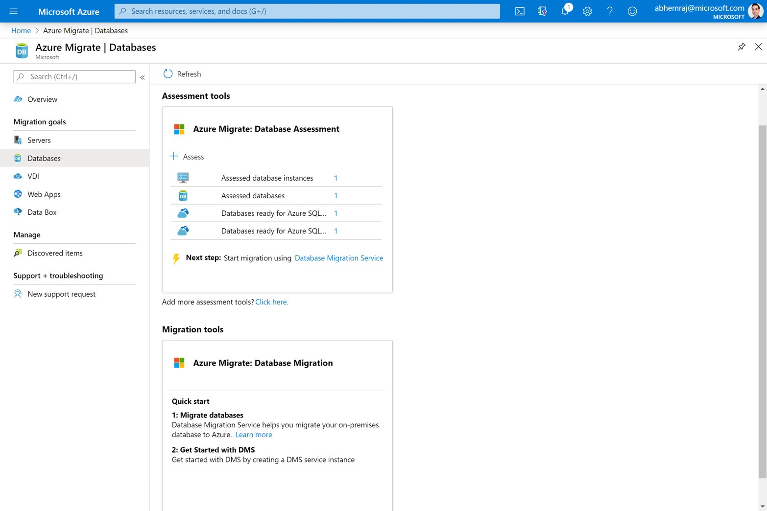
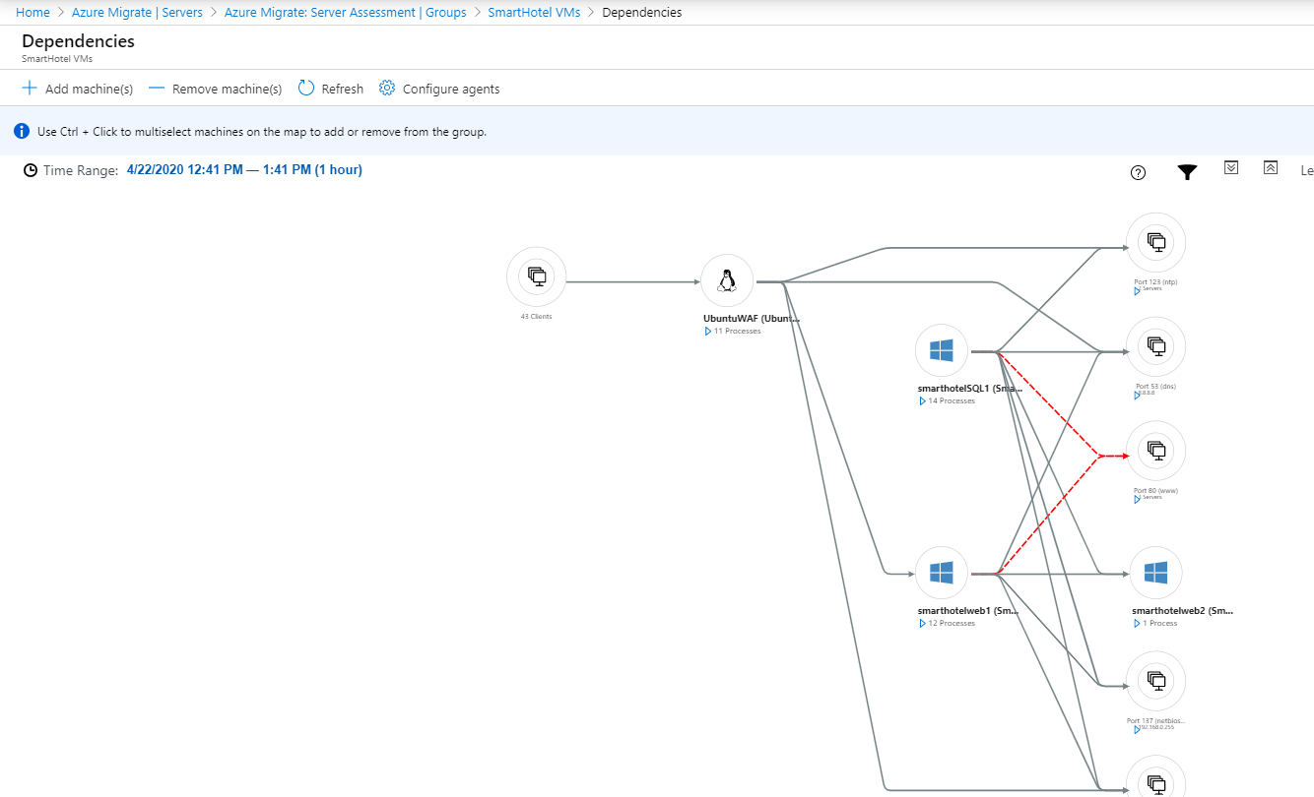
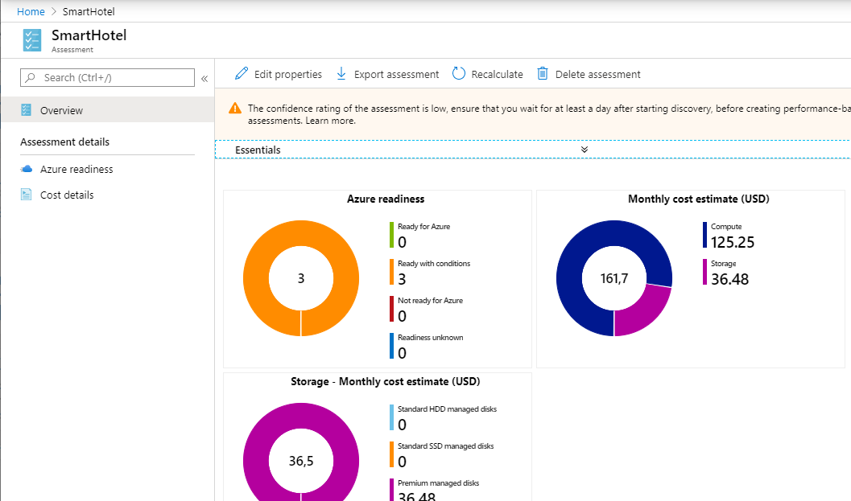
Assessments with Azure Migrate
Discover your whole on-prem or other cloud server environment without agents
Get a clear picture of existing dependencies and connections and create groups for assessment
Assessment output includes estimated cloud cost and recommended VM sizes
Notes:
Assessment capabilities in the Azure Migrate: Server Assessment tool. You can do this all without downloading agents, by downloading the Azure Migrate appliance or by uploading inventory data via CSV upload. You can get assessment results for either migrating to Azure VMs or Azure VMware Solution, to use as a comparison and craft a migration that works best for your project.

Slide 11
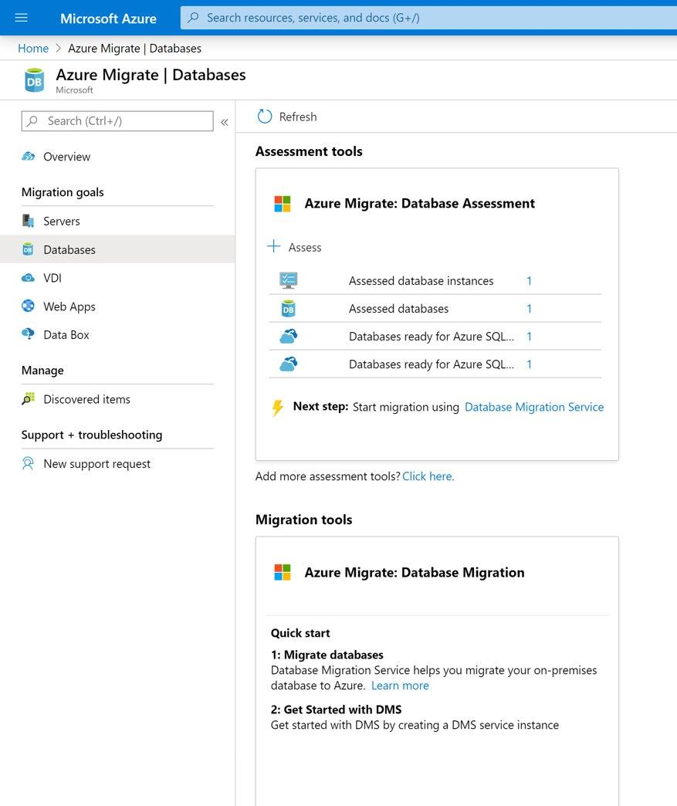
Database Assessment with Azure Migrate
Assess your on-premises database readiness
DMA report includes SKU recommendations based on collected performance data
Based on recommended SKU, receive an estimated monthly cost of migrating your on-premises environment to Azure
Notes:
You can click on the database scenario in Azure Migrate to add the Azure Migrate: Database Assessment tool. This launches Data Migration Assistant (DMA), which assesses on-premises databases for Azure readiness and provides SKU recommendations for migrating databases to Azure.

Slide 12
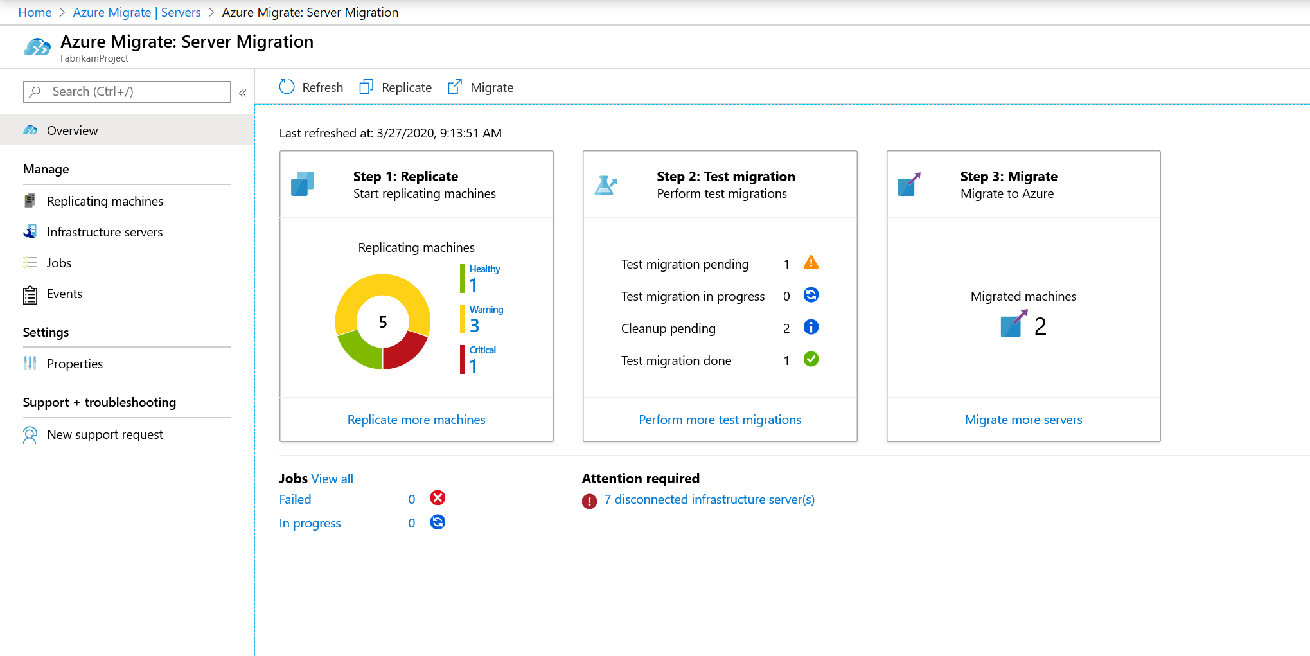
Migrations with Azure Migrate
Automatically apply groupings from assessment to migration
Perform a test migration
Pin migration to Azure Availability Zones
Cutover to Azure with zero data loss
Notes:
After assessing your datacenter environment, you’re ready to migrate workloads safely. You can use the Azure Migrate: Server Migration tool to rehost server workloads to Azure. Migrate the same groups you created with the assessment tool, to ensure you’re considering proper dependencies when you migrate workloads together. Azure Migrate lets you perform a test migration to check how the migration will occur without impacting on-premises machines. After, clean up the test and migrate your workload groups. You can now migrate to specific Azure Availability Zones within a region.
You can perform the migration either with or without agents. Azure Migrate lets you shut down on-premises VMs during cutover to ensure no data loss.

Slide 13
Demo - Azure Migrate
Notes:
Sample demo video: https://youtu.be/0s2ZqHgieT0

Slide 14
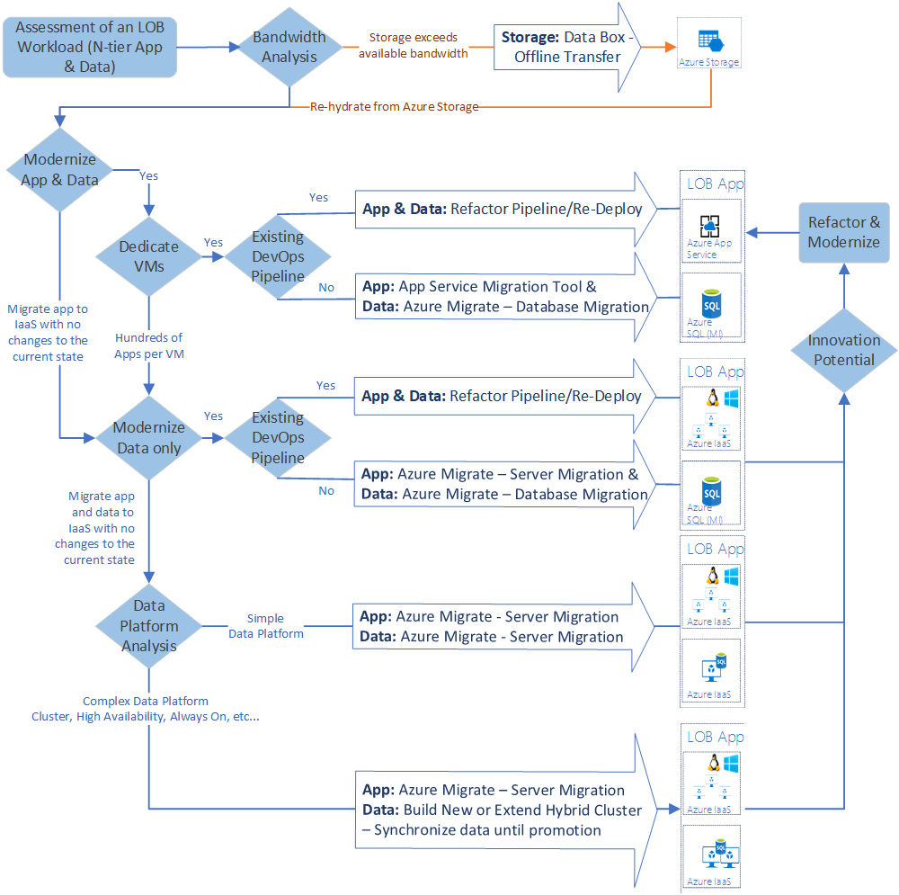
Migration tooling Options
Expand workload architecture options w/ broader tooling
Migration is more than a lift & shift rehost to IaaS using tools like Azure Migrate.
Modernize some assets during migration with PaaS focused solutions like Database Migration Service
Over time, refactor and modernize any workloads that represent innovation potential
Notes:
Lift and shift – large majority of customers still prefer this method, at least at first. Reduces capital expenses, frees up datacenter space, and provides rapid return on investment in the cloud with minimal risk versus other migration methods (modernization). Especially in demand with COVID pandemic where organizations are limited on cash flow and want to backup quickly.
Think beyond lift and shift – and look at other tools and other deployment options.

Slide 15

Azure Migrate resources
Learn more aka.ms/AzureMigrate​
Documentation aka.ms/AzureMigrateDocs​
Azure Migration Blog aka.ms/MigrationBlogs
Azure Migrate Demos aka.ms/AzureMigrateGettingStarted
E-Book
aka.ms/AzureMigrateEbook
Learning path
aka.ms/AzureMigrateLearning

Slide 16
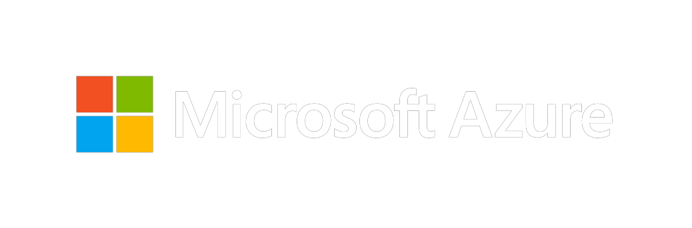
Thank you for joining us.
© 2018 Microsoft Corporation. All rights reserved. Microsoft, Windows, Windows Vista and other product names are or may be registered trademarks and/or trademarks in the U.S. and/or other countries.
The information herein is for informational purposes only and represents the current view of Microsoft Corporation as of the date of this presentation. Because Microsoft must respond to changing market conditions, it should not be interpreted to be a commitment on the part of Microsoft, and Microsoft cannot guarantee the accuracy of any information provided after the date of this presentation. MICROSOFT MAKES NO WARRANTIES, EXPRESS, IMPLIED OR STATUTORY, AS TO THE INFORMATION IN THIS PRESENTATION.

